Slide 2
FUNCTIONS OF THE SKULL
Encloses and protects the brain
protects the olfactory organs, eyes and the inner and middle ear

Slide 3
THE VERTEBRAL COLUMN

Slide 4
THE VERTEBRAL COLUMN
It consists of bones called the vertebrae.
The number of the vertebrae varies from species to species
There are 33 vertebrae in the human skeleton

Slide 5
The vertebrae are placed end to end and therefore run from the base of the skull to the pelvis
The bones are separated from each other by cartilage called intervetebral disc

Slide 6
FUNCTIONS OF THE VERTEBRAL COLUMN
Support the trunk
Protects the spinal cord

Slide 7
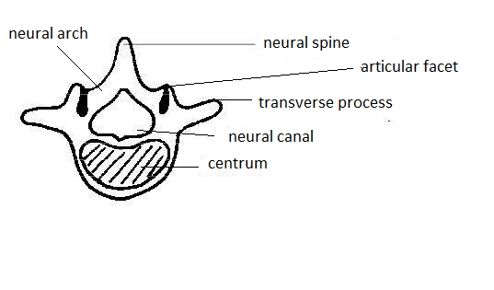
The basic structure of a vertebra

Slide 8
FUNCTIONS OF INTERVETEBRAL DISC
Acts as a cushion that absorbs shock
Reduces friction between bones
Makes the vertebral column flexible by allowing for certain degree of movement between the vertebrae.

Slide 9
THE CERVICAL VERTEBRAE

Slide 10
These are the bones/ vertebrae found at the neck region.
They are 7 in number in human beings.
The first bone of the cervical vertebrae is called the atlas
The second one is called axis.

Slide 11
THE ATLAS

Slide 12
Broad facets
Vertebraterial canal

Slide 13
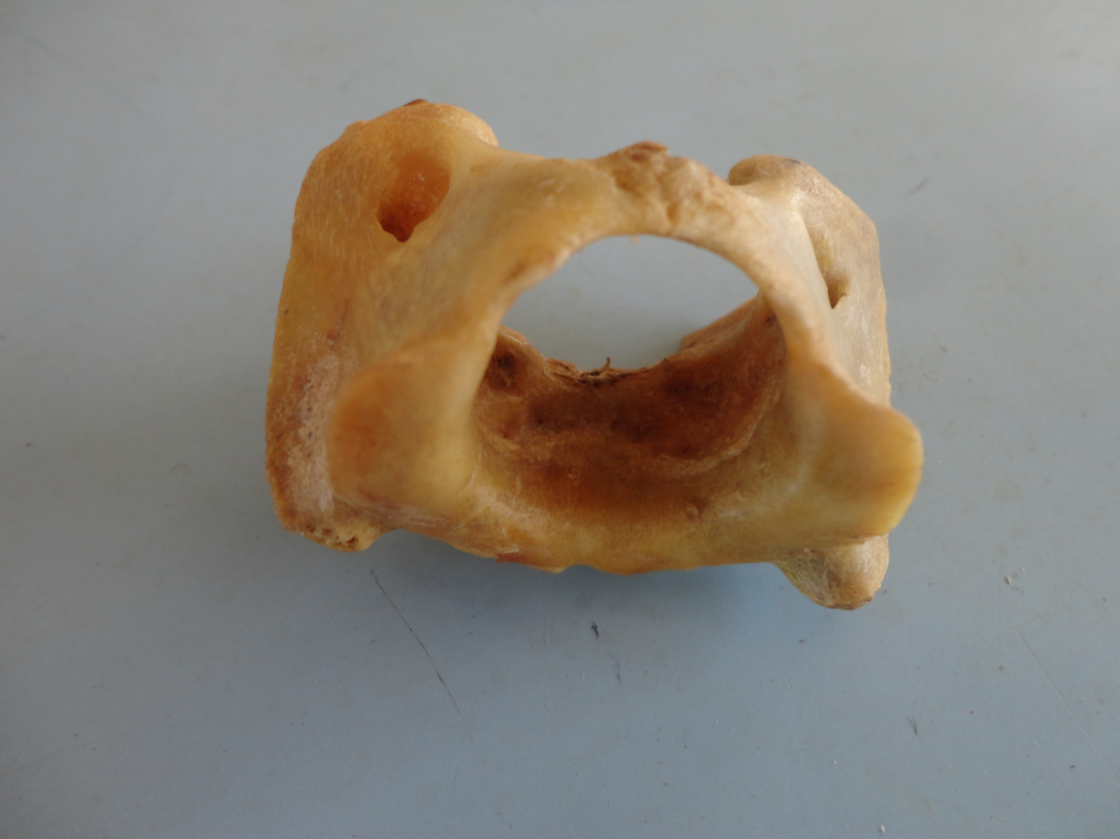
Vertebraterial canal
Large facets
Wide Neural Canal

Slide 14
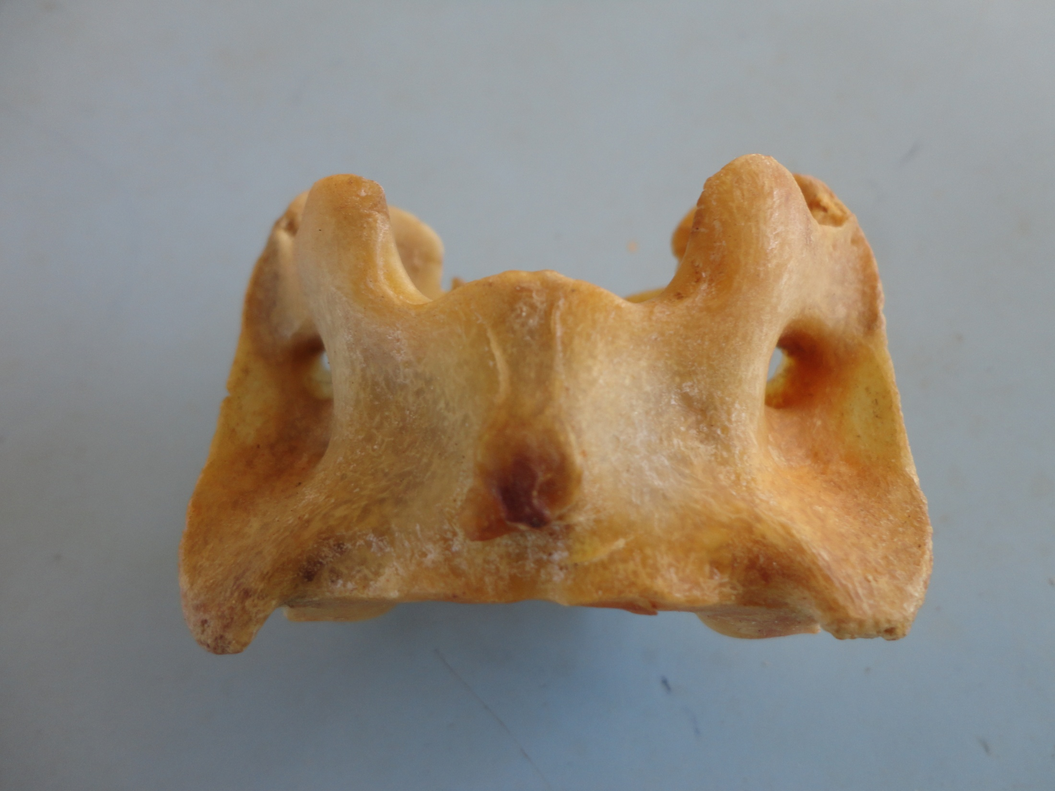
transverse process

Slide 16
Has a broad (facets)surface for the articulation with the condyles of the skull to form a hinge joint which allows for nodding of the head.
Has a small neural spine
Has no centrum
lacks prezygapophyses and postzygapophses

Slide 17
5. Has broad and wing like transverse processes to offer a large surface area for the attachment of the neck muscles.
6. Has a wide neural canal for the passage of the large spinal cord of the neck
7. Has vertebraterial canals

Slide 18
NB
The wide neural canal of the atlas also fits into the odontoid process of the axis to form pivotal joint

Slide 19
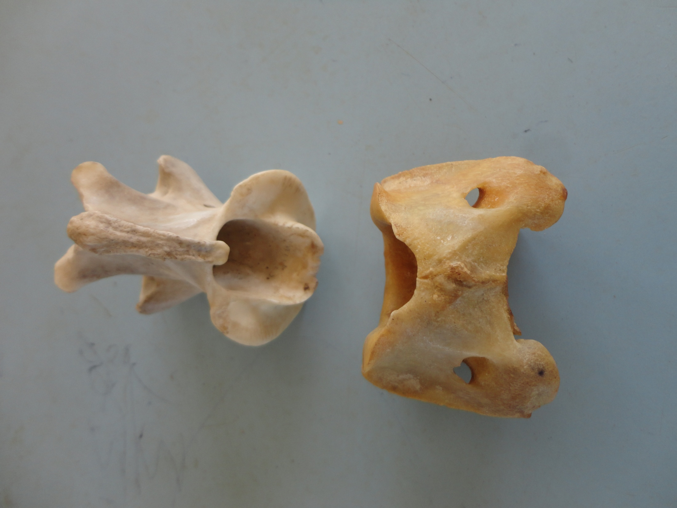
Axis
Odontoid Process
Atlas

Slide 20
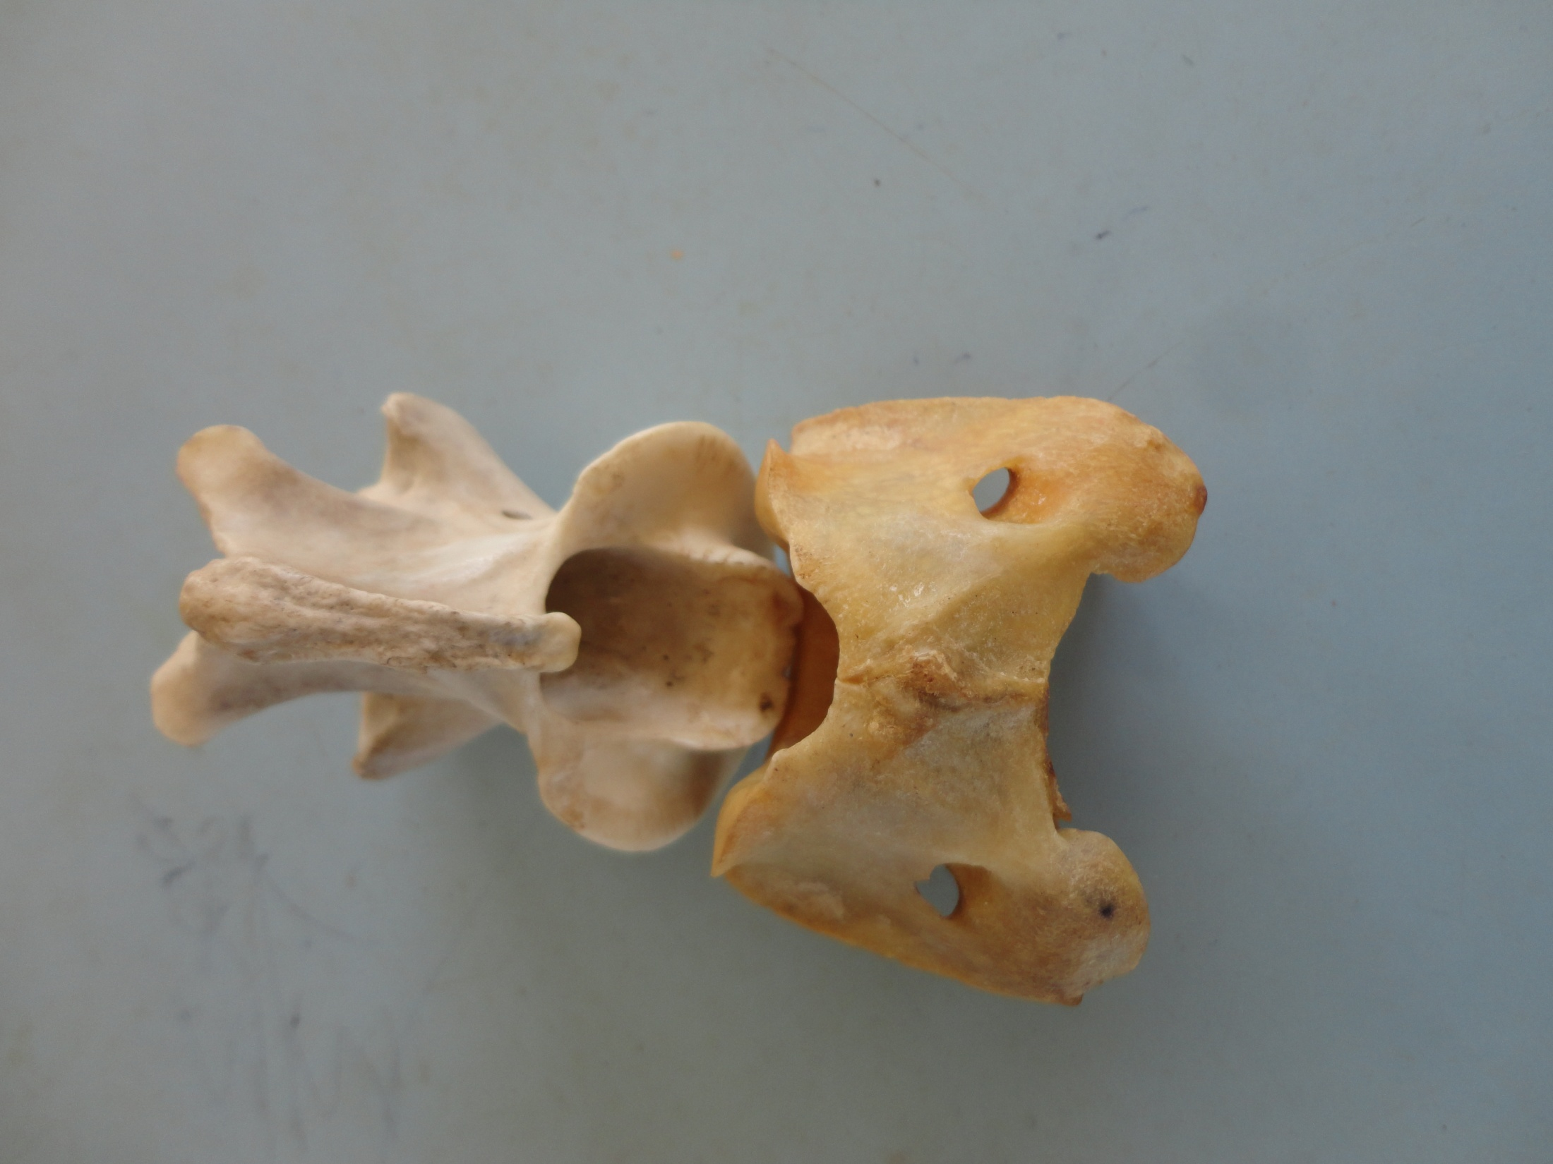

Slide 21
CHARACTERISTICS OF THE AXIS

Slide 22
Has a broad neural spine
Has a wide neural canal
Has wing like transverse process
Has a broad centrum which projects in front to form an odontoid process. The odontoid process forms a peg which fits into the neural canal of the atlas forming a joint which allows the turning/ rotary movement of the head

Slide 23
Axis Cont.
Lacks prezygapophysis
Has vertebraterial canal

Slide 24
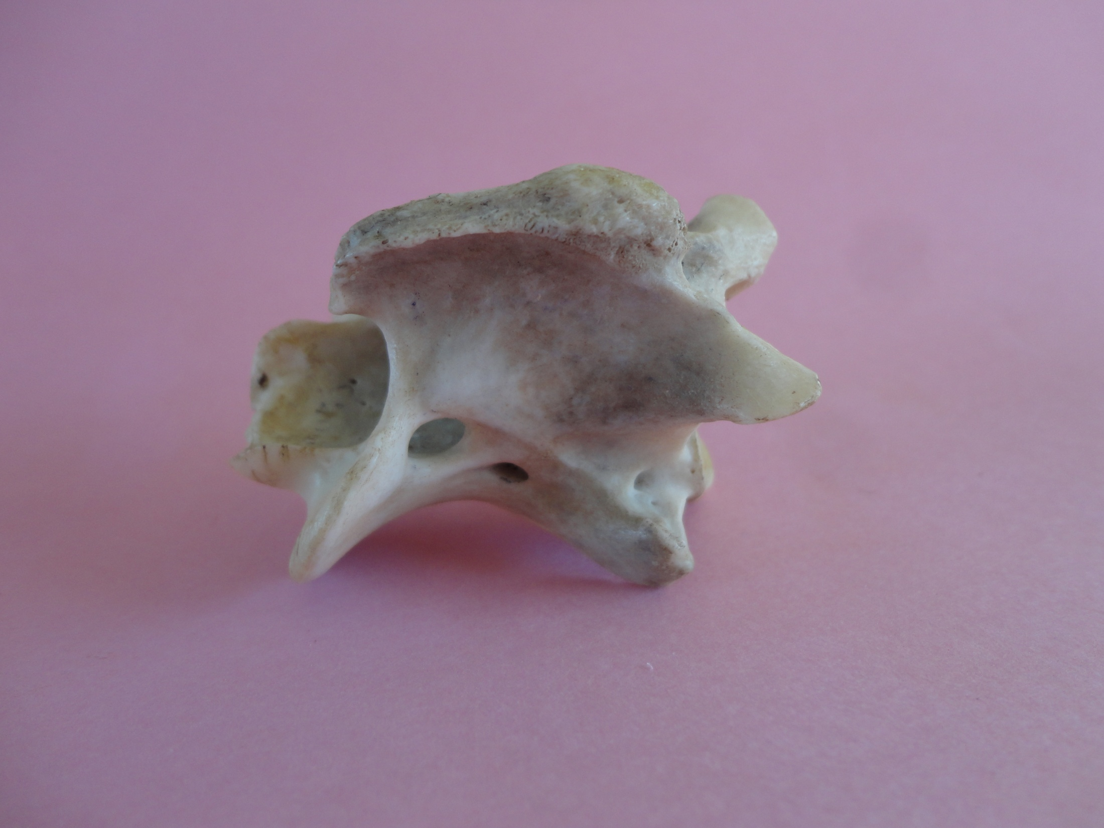
Neural spine
postzygapophysis
Odontoid Process
Vertebraterial canal

Slide 25
Characteristics of cervical vertebrae
Have a short neural spine
Has a small but wide centrum
Has a wide neural canal
Has vertebraterial canals for the passage of blood vessels/ vertebral artery

Slide 26
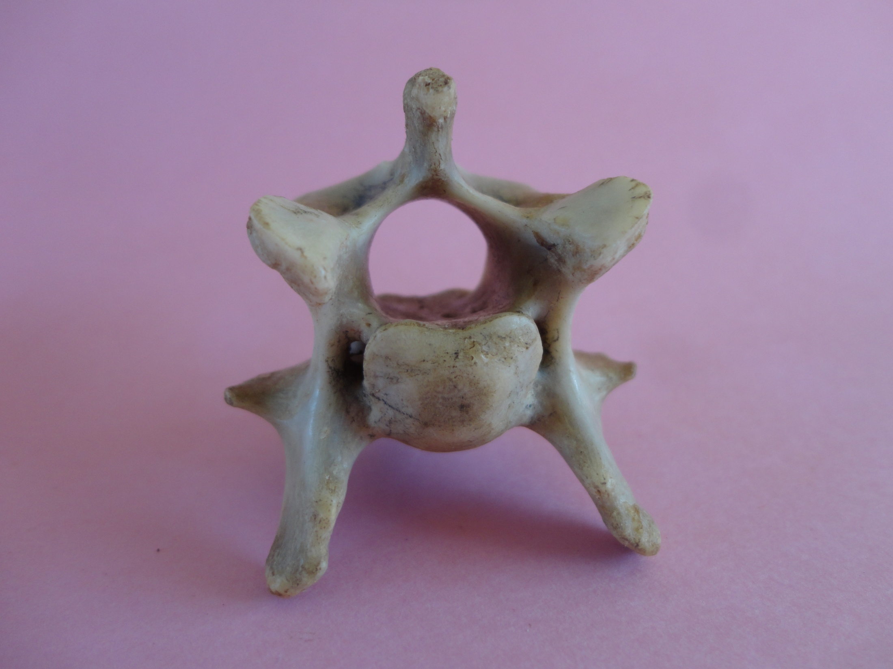
A
B
C
D
E
F
H
G

Slide 27
THORACIC VERTEBRAE
A
B
E
C
D

Slide 28
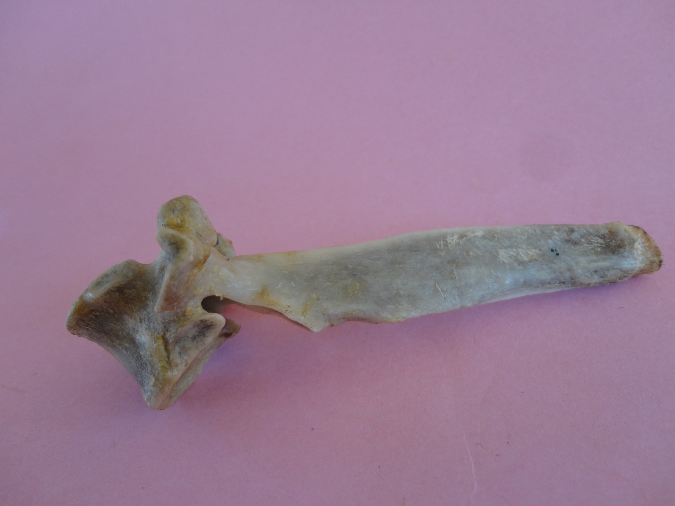
Neural spine
Capitulum demifacets
Tuberculum

Slide 29
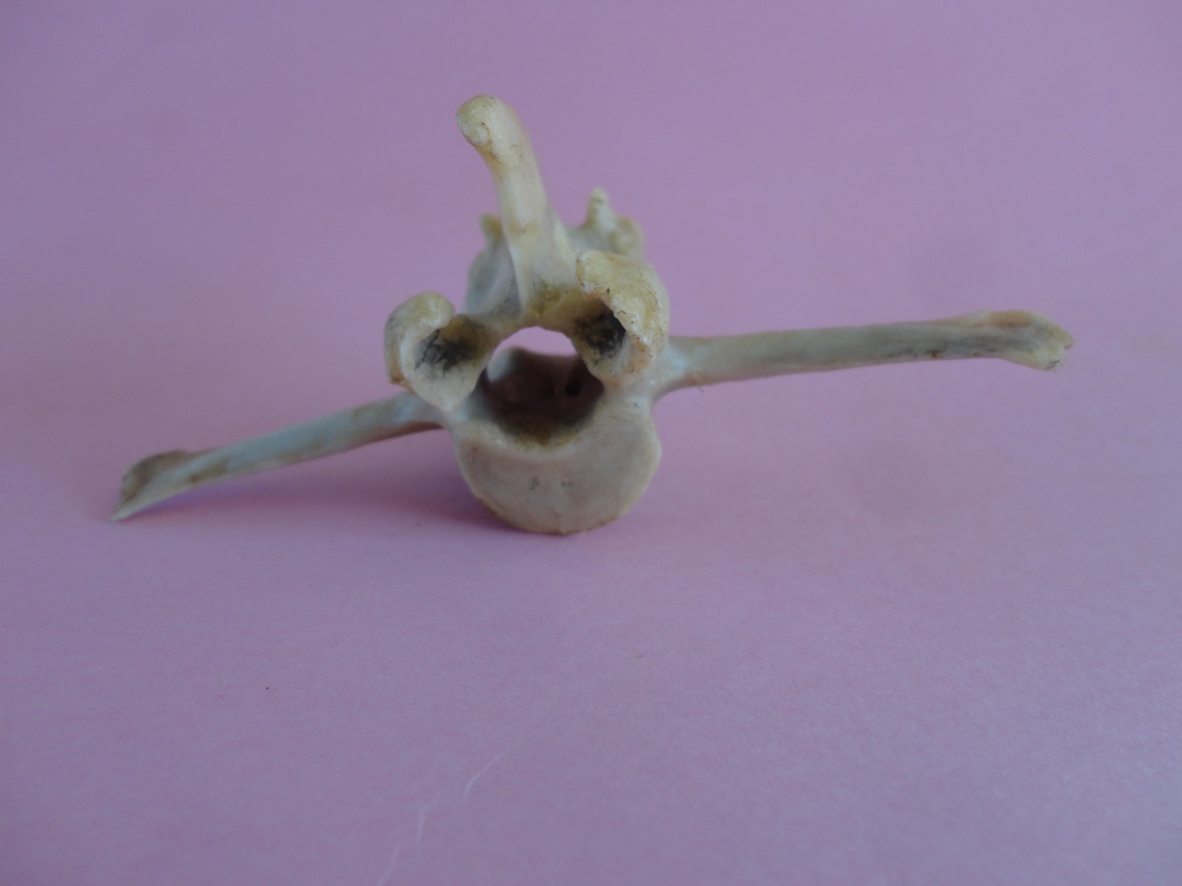
LUMBER VERTEBRAE

